Slide 1
URL SHORTENING SERVICE
(an ALTERNATIVE SOLUTION TO TINY URL AND BITLY SERVICES)

Slide 2
CONS OF USING LONG URL
Broken links
Loss of opportunities
NON-USER FRIENDLY SYMBOLS
SEO IMPACT
A bad user exPEriencE

Slide 3
CONS OF USING URL SHORTENERS
Abuse
Dead Link(SERVICE, $)
Advertising
Blocking
HACKING
Privacy and Security Breach
TinyUrl.com
Bit.ly
Goog.le
Hyperlink
Ow.ly
Short.io

Slide 4
ONE STOP SOLUTION
TO DESIGN OUR customized URL SHORTENERS

Slide 5

HOW TO DESIGN?
https://www.educative.io/courses/grokking-the-system-design-interview/m2ygV4E81AR
https://tinyurl.com/rxcsyr3r
A CUSTOMISED URL SHORTENING SERVICE

Slide 6
BASIC SYSTEM DESIGN & ALGORITHM
REST API
DATABASE DESIGN
HASH ALGORITHM
SPRING BOOT STARTER WEB
CREATE URL:: POST
(ORIGINAL_URL, EXPIRY_DATE)
DELETE URL::DELETE
(SHORT_URL)
REDIRECT URL::GET
(SHORT_URL)
H2 DATA BASE
ID(int)
ORIGINAL URL(clob)
SHORT URL(varchar)
CREATED AT(timestamp)
EXPIRED AT(timestamp)
MURMUR 3(unique hash)
GUAVA(THIRD PARTY LIBRARY FROM GOOGLE)
APACHE COMMANS LANG3(StringUtils)

Slide 7
CUTOMIZED URL SHORTENING SERVICE
DATA REPLICATOIN
LOAD BALANCING
CACHING
CAPACITY ESTIMATIONS
TRAFFIC
RATE LIMITING
Points to be remembered
while
Creating an API or Service

Slide 8
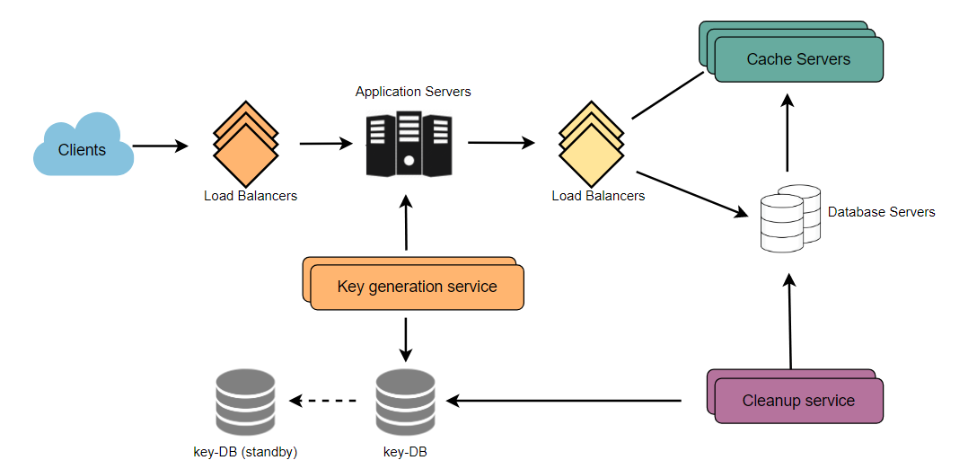
DETAILED COMPONENT DESIGN FOR URL SHORTENING SERVICE

Slide 9
HOW TO IMPLEMENT URL SHORTENING SEVICE?
STATUS: 404
"ERROR"
IF NULL
STATUS: 400
"URL DOES NOT EXIST"
IF NULL
OR ERROR IN SHORT URL
LONG URL
GENERATE UNIQUE SHORT URL
IF PRESENT IN DB & VALID TIME
REDIRECT TO
LONG URL
IF EXPIRED
STATUS: 200
"URL EXPIRED"

Slide 10
FUTURE IMPLEMENTATION
This project paves a solution not only for standard URL shorteners(Bit.ly etc...) but also for distributed URL Shortening services like Zookeepers(Apache Foundation).
To use AWS Scaling property(for load balancing issue), so we can increase the number of user access.

Slide 11
THANK YOU......

